Slide 1
Your Water System
Sources of Water
  reservoir
  underground aquifer
Energy Sources
  pumps
  gravity
Distribution Network of Pipes

Slide 2
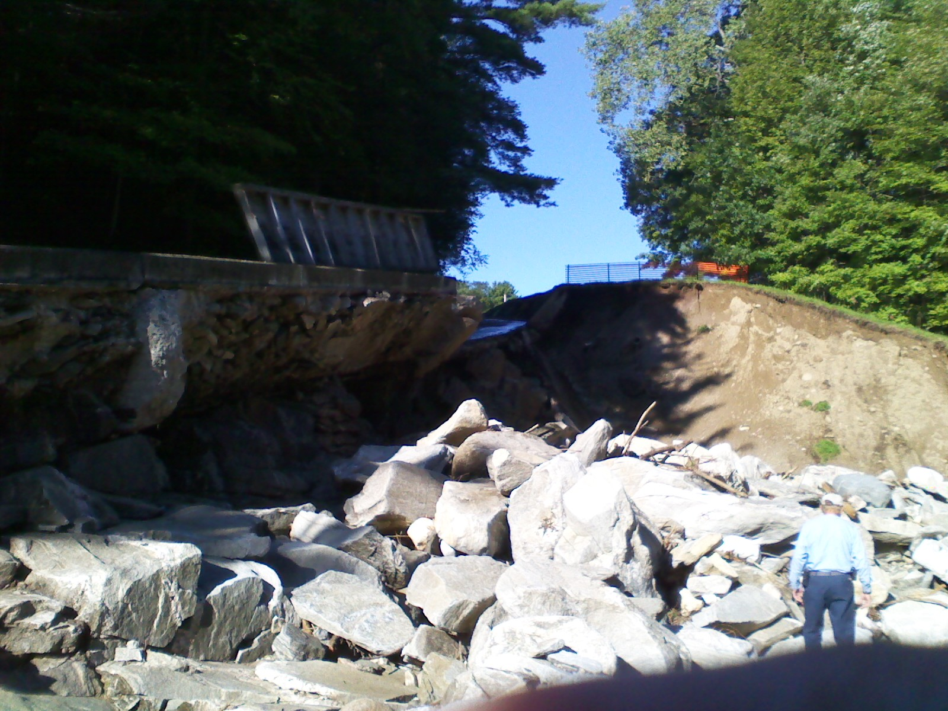
Spillway Collapse

Slide 3
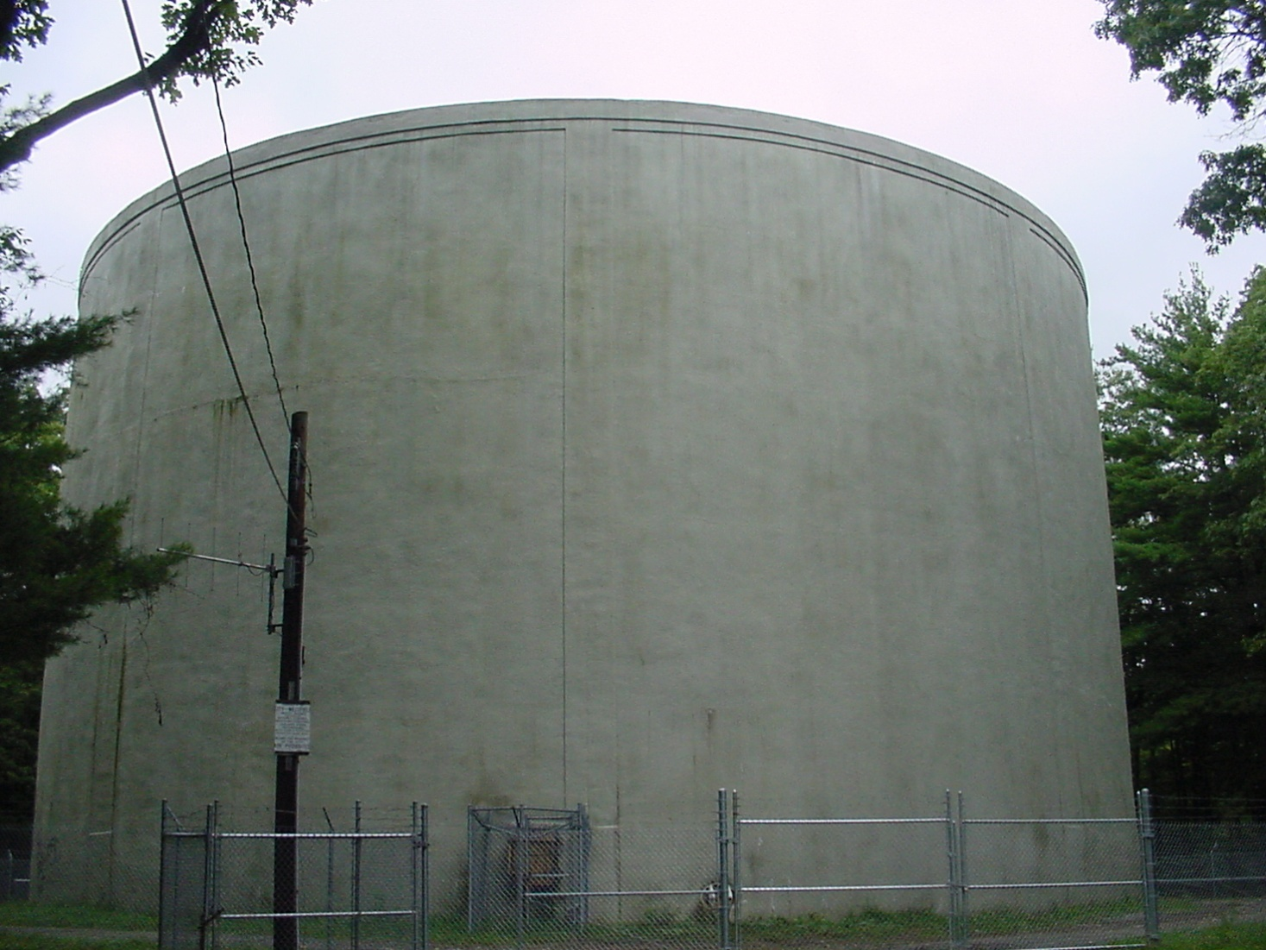
East Mountain Tank
Constructed in 1962
Holds 2.7 million gallons of water
55 feet in height
Refurbished in 2001

Slide 4
Distribution System
Maintain over 220 miles of water mains
Install new services and mains
Maintain over 2,000 fire hydrants
Hard and often dangerous work
Subject to call outs 24 hours a day 7 days a week
Flush mains
4 Water Tanks
4 Booster Pumping Stations
11,000 Residential and Commercial Customers

Slide 5
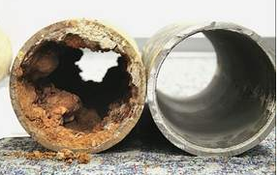
What Happens to Pipe Over Time

Slide 6

What Does Your Water Cost
$2.95 per 1,000 gallons
Average Annual
Cost is $300
Massachusetts Infrastructure Finance Commission Recommends Rates Should be 1.25% of Median Income, In Westfield This Would Equate to $500 Annually

Slide 7
Comparatively Speaking
One 16 ounce bottle of water cost about $1.25 if you buy it in the store
You could fill 3,400 bottles for the same price with city water or the cost would be $0.00037 per bottle
Bottled water cost $10,000/1000gallons
City water cost $2.95/1000 gallons

Slide 8

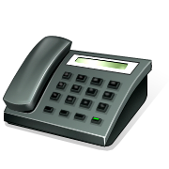
Comparatively Speaking
Monthly Water Bill ~ $25
Monthly Phone Bill ~ $175
Monthly Cable Bill ~ $150
One Trip to the Movies ~ $25

Slide 9
Where Does the Money Go

Slide 10
Present Projects
Granville Spillway Repair $1,910,ooo
Granville Dam Repair $1,000,000
Granville Raw Water Pipeline $2,847,000
Water Meter Replacement $3,950,000
Gaslight Main Replacement $2,300,000
Total $12,007,000

Slide 11
Undesignated Breakdown

Slide 12
Cuts to Operating Budget and Required to Set Tax Rate
Annual Cuts
2011 - $369,000
2012 - $502,000
2013 - $400,000
2014 - $435,000
Total Amount Cut = $1,706,000
Average Amount Cut = $426,500

Slide 13
Previous 5 Years Revenue
Fiscal Year | 2010 | 2011 | 2012 | 2013 | 2014
Total Revenue | $ 4,911,582.13 | $ 4,516,508.63 | $ 4,770,591.23 | $ 5,405,811.10 | $ 4,828,646.64
User Portion | $ 4,091,974.11 | $ 3,618,326.63 | $ 3,829,457.22 | $ 4,939,065.76 | $ 4,043,908.22
% of Revenue | 83% | 80% | 80% | 91% | 84%

Slide 14
What Does It All Mean
The average shortfall in the operating budget over the last 4 years is $426,500
There are $12,000,000 is projects that will go on the books in the next 2 or 3 years
A $1 million in payments add roughly $70,000 to debt service the first year and it drops about 2% a year going forward
A 10% increase in rates (including base charge) generates about $400,000 annually

Slide 15
